Slide 1

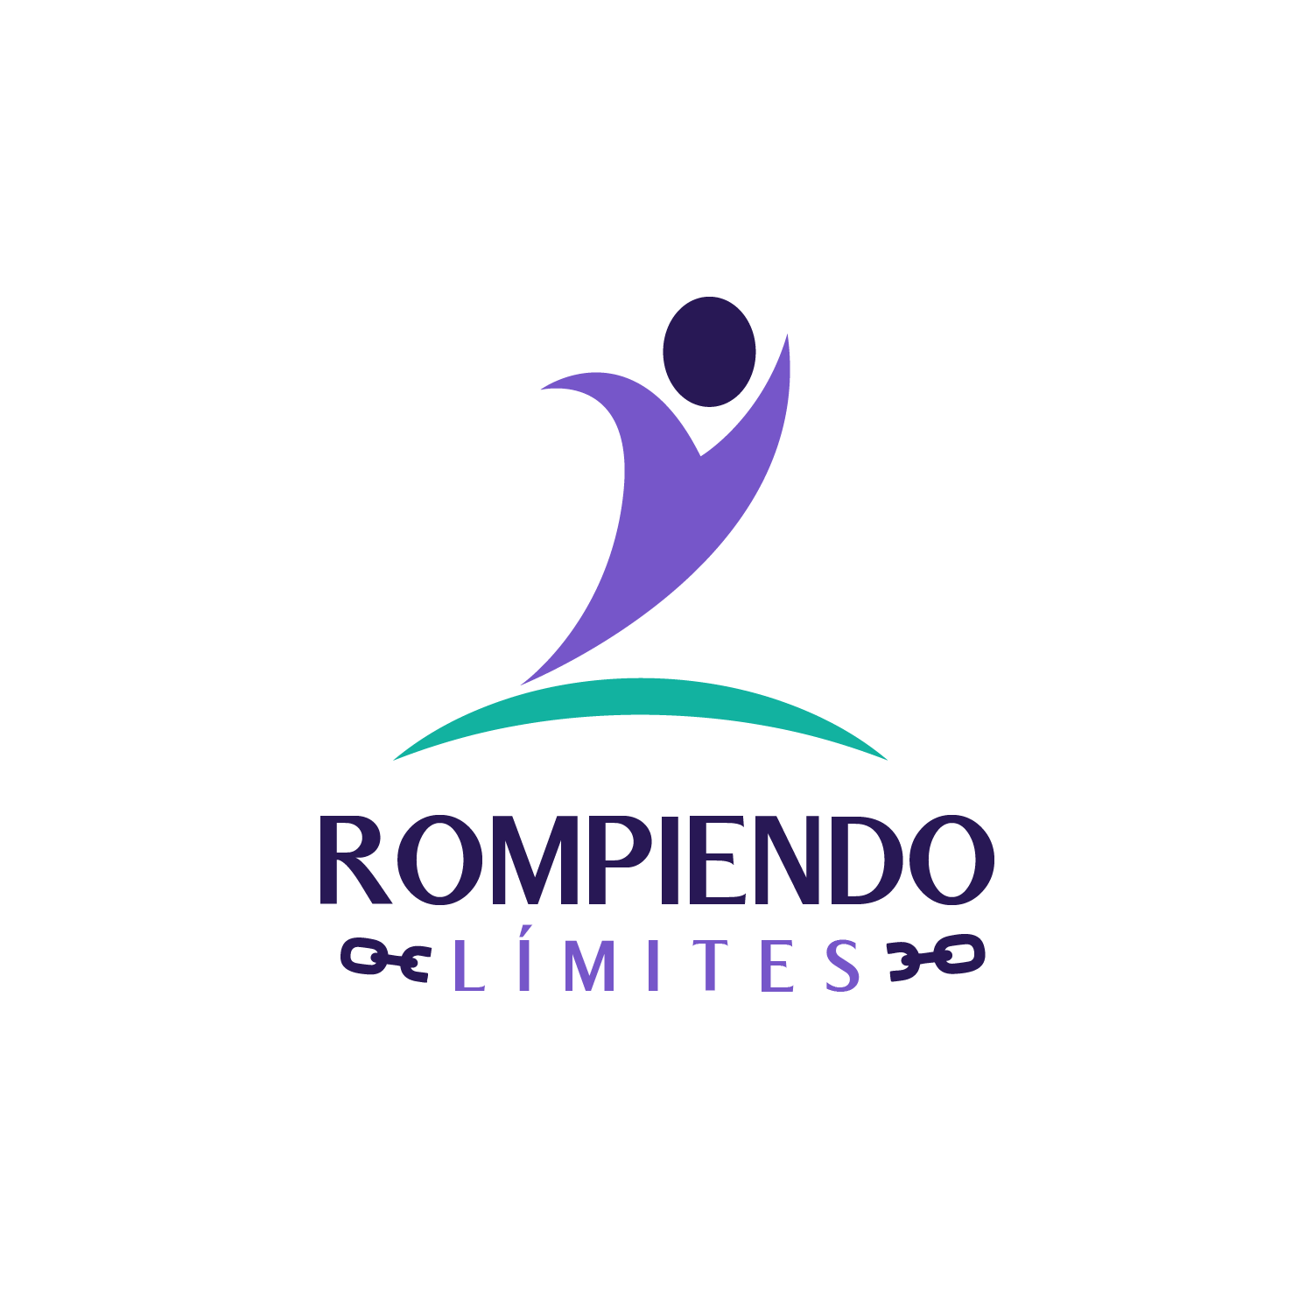


Slide 2
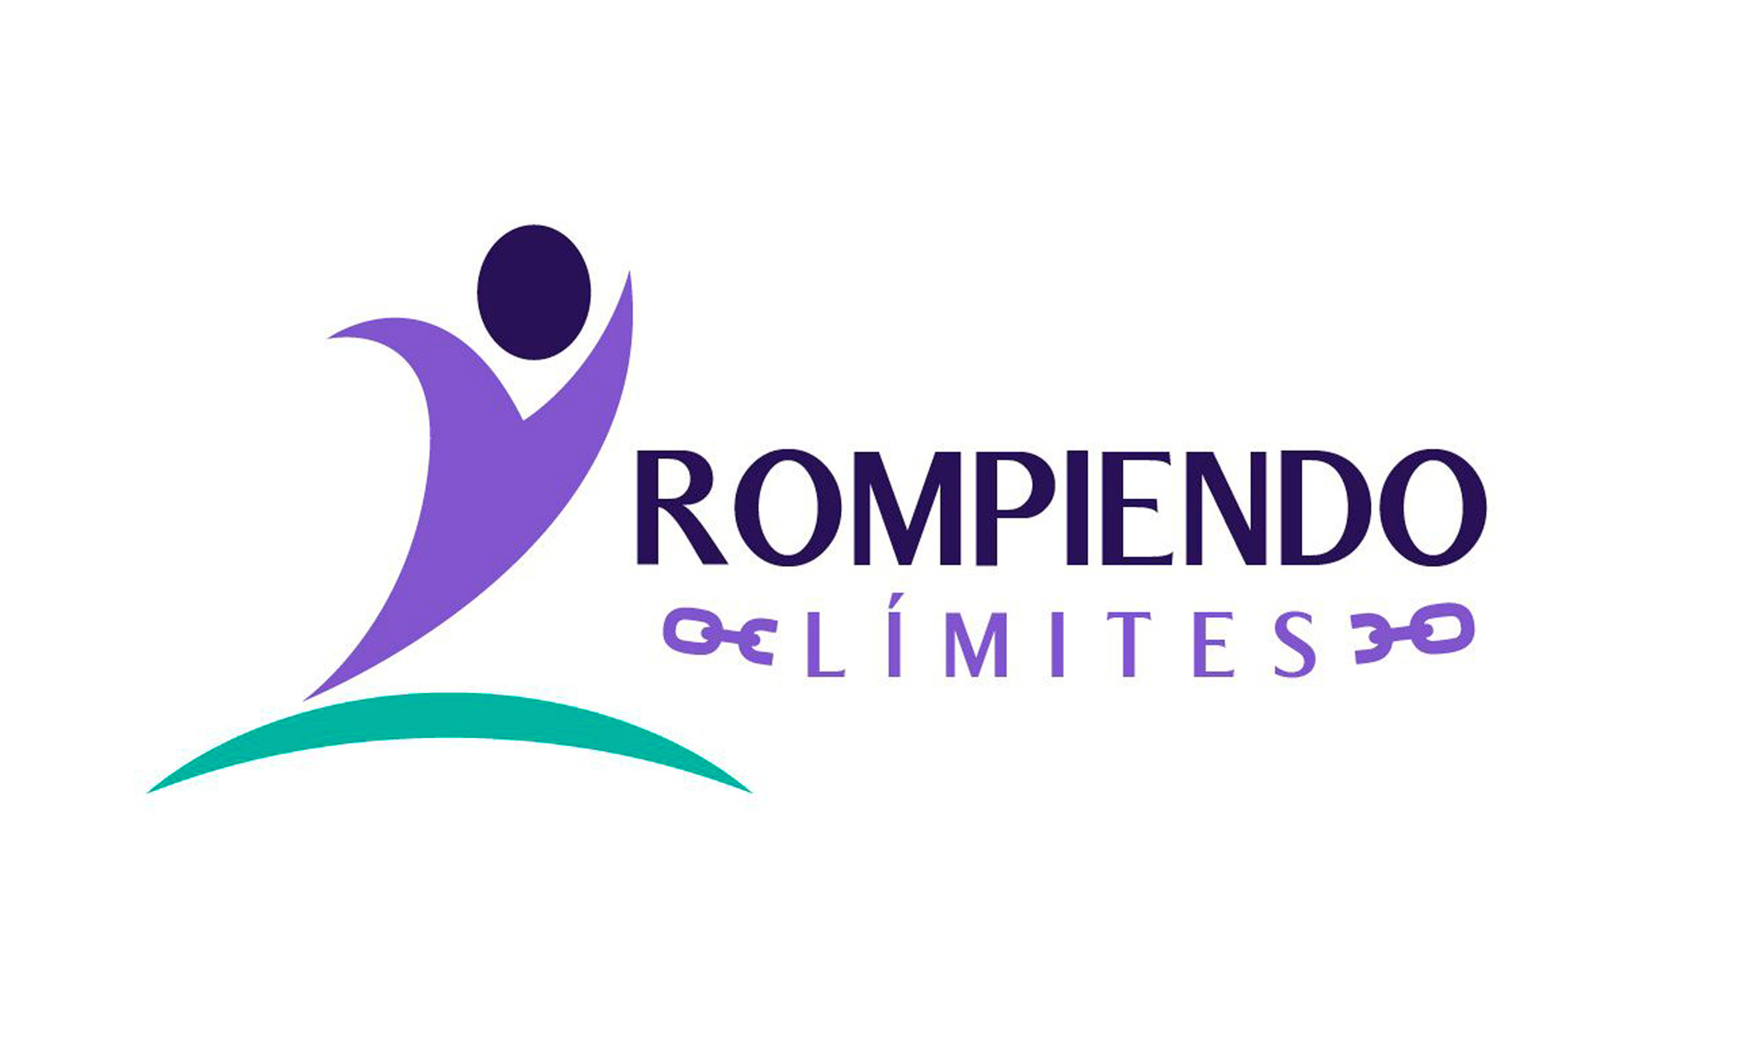
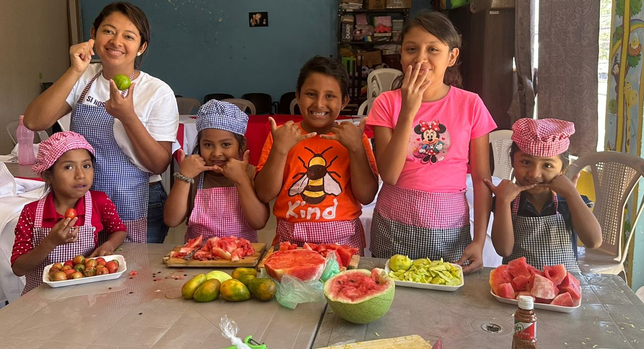

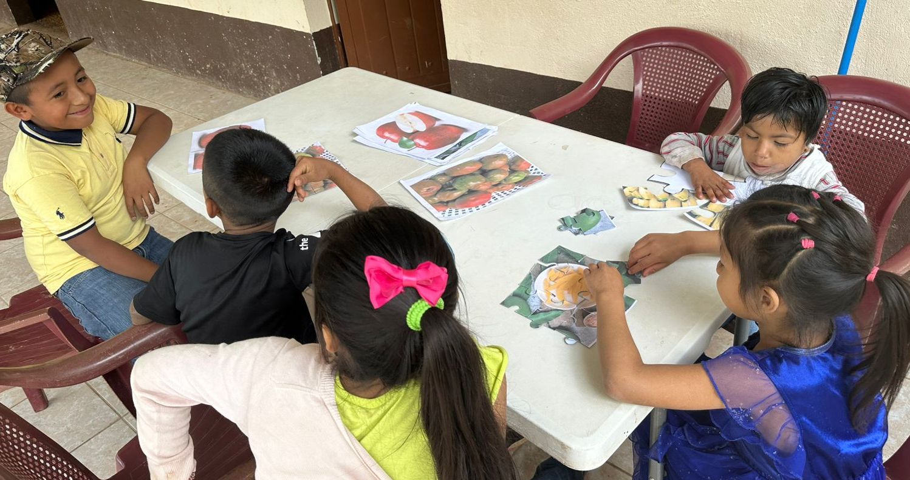
History
Founded in 2018 in Chiquimula, Guatemala, by a group of people with and without disabilities seeking to improve quality of life.
We work under a human-rights approach inspired by the UN Convention on the Rights of Persons with Disabilities (2006).
Mission
We promote and strengthen the inclusion and empowerment of persons with disabilities and their families within society and their communities through a rights-based approach.
Strategic Pillars
Institutional Strengthening
Good Practice Models
Advocacy for Inclusive Development
Leadership of Persons with Disabilities

Slide 3

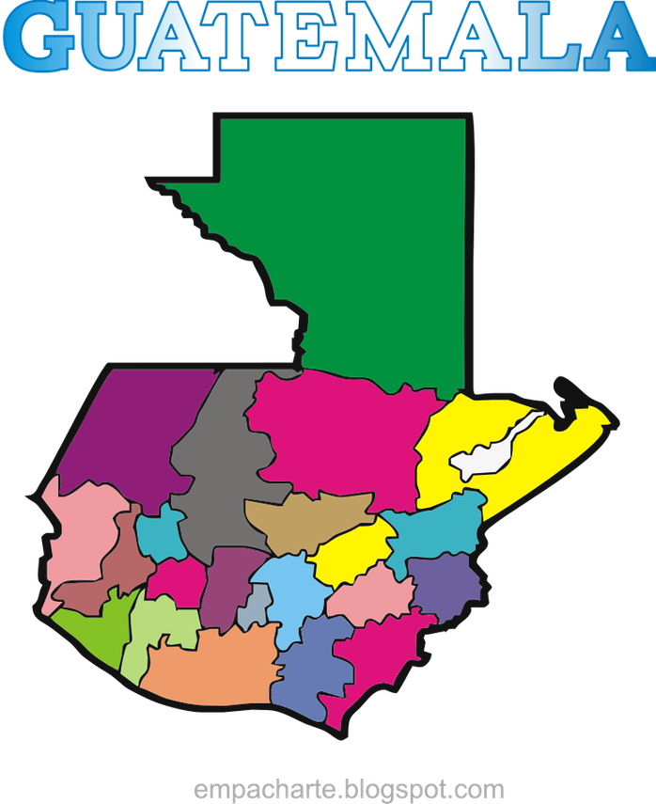
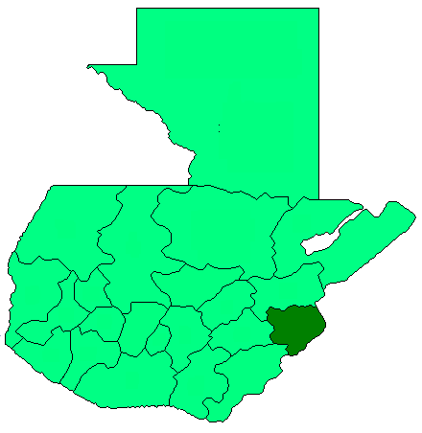
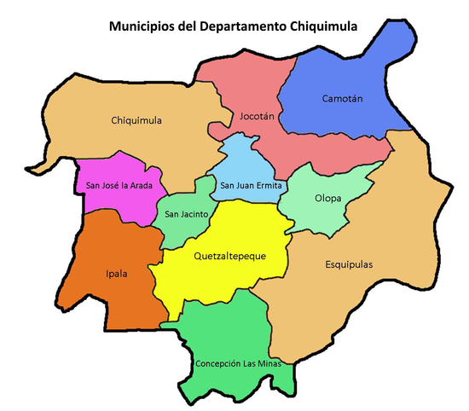

Coverage Area

Slide 4
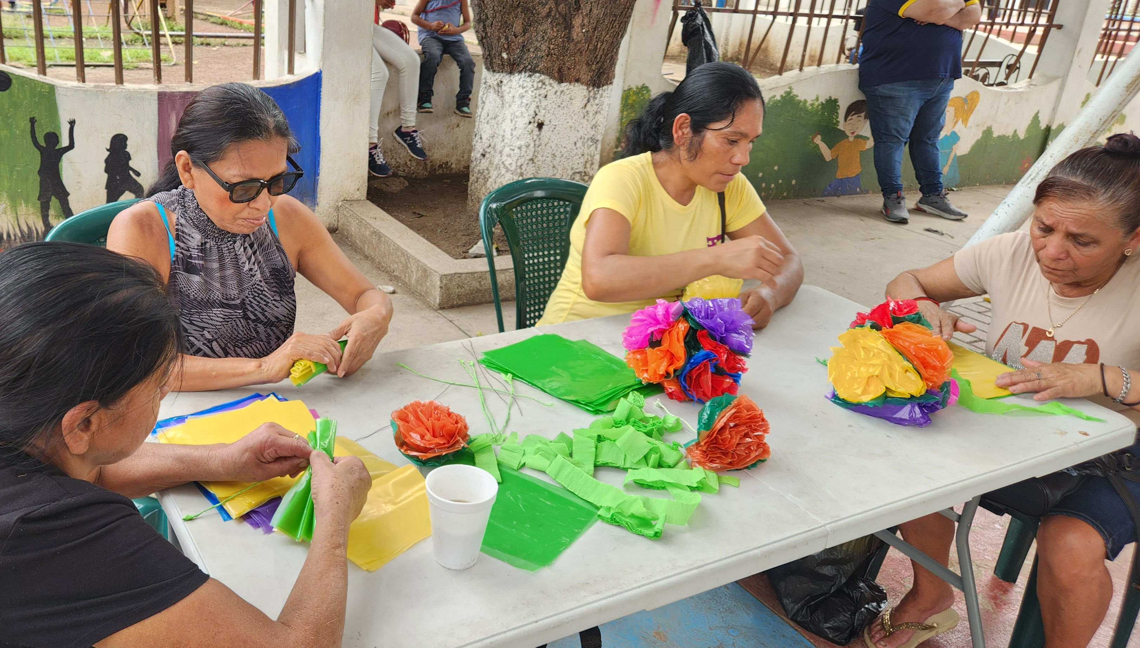
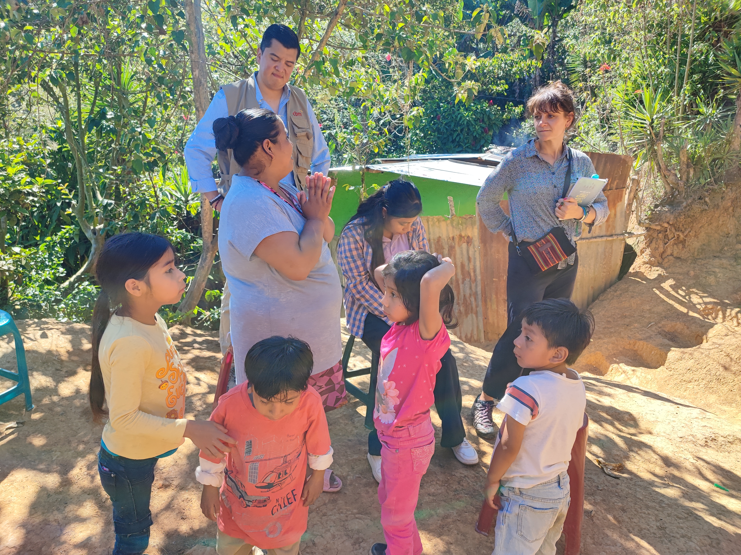
Our Community
10.38%
1.4M+
1,714
of Guatemala's population lives with a disability
persons with disabilities in Guatemala
persons identified in municipal disability registries in Chiquimula
In 2026, we work in 9 municipalities in the department of Chiquimula with rural and Indigenous communities facing high levels of poverty and social exclusion.
The population served includes children, youth, and adults with disabilities and their families living in poverty or extreme poverty.
Community Participation
Persons with disabilities, their families, and community stakeholders actively participate in the Assembly, Board of Directors, and program implementation, identifying the most urgent needs.

Slide 5
Community Participation and Safeguarding
Community Participation
Safeguarding Policy
Persons with disabilities, caregivers, families, and communities directly influence the priorities, programs, and decisions of Breaking Limits.
They actively participate in the Members' Assembly, Board of Directors, and program implementation team.
Breaking Limits has a safeguarding policy that protects children, youth, persons with disabilities, women caregivers, and people in vulnerable situations.
The policy is implemented with:
Organization staff and volunteers
Participation Mechanisms
Members, families, and schools
Health providers and community workers
Members' Assembly
Strategic decision-making
Board of Directors
Technical and administrative oversight
Program Implementation
Community Team
Local governments and municipalities
"Persons with disabilities are key actors in decision-making processes and in building more equitable communities."

Slide 6
Results Achieved in 2025
2,087
10,435
1,714
8,565
Direct beneficiaries
Indirect beneficiaries
In municipal registries
People trained
Health, Education and Well-being
Empowerment and Social Protection
148 children received specialized medical care
81 people with spina bifida and hydrocephalus received specialized treatment
76 deaf persons improved their sign language skills
75 blind and low-vision persons increased their independence through visual rehabilitation
164 children gained access to educational scholarships and inclusive education
798 people included in social protection programs
750 people included in formal disaster risk management systems
25 women caregivers participating in therapeutic arts processes
45 women with disabilities involved in 3 municipal protection networks
Governance and Institutional Strengthening
2 members' assemblies for strategic decision-making | 12 board meetings | 16 internal training workshops
2 persons with disabilities employed by Breaking Limits | Partnerships with 9 municipalities
Creation of 4 municipal disability registries

Slide 7
Integrated Programs 2026
Rights Transition Plan
Direct Inclusive Actions
424 participants with access to social protection
164 people — sign language, low vision, and eye health services
PROGIS — Gender-Sensitive Social Protection
ASHI — Water, Sanitation and Hygiene for Inclusion
Access to social protection mechanisms with a gender perspective
Strengthening 3 women's networks for policy advocacy
25 rural families — access to safe water and basic sanitation
Sendai Framework — Disaster Risk Reduction
Municipal Disability Registries
40 persons with disabilities — early warning systems and inclusive drills
4 municipalities with active registries addressing identified data gaps
Spina Bifida and Hydrocephalus
Inclusive Education
100 children and youth — specialized medical care and follow-up
210 children with access to scholarships, assistive devices and adaptive technologies that remove communication barriers and support inclusion
Women's Transformation
50 women caregivers and women with disabilities — empowerment and rights
Our programs address the holistic needs of persons with disabilities and their families, from specialized healthcare and inclusive education to economic empowerment and policy advocacy.

Slide 8
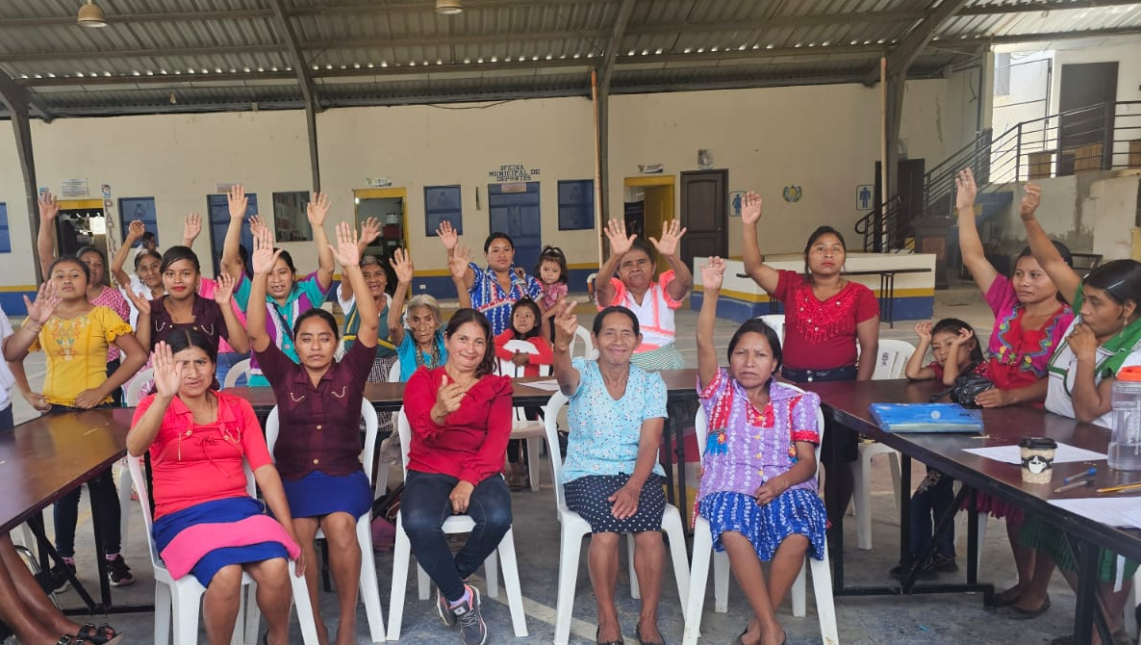
Impact and Approach
Breaking Limits coordinates with rural leaders, community networks and government institutions to support persons with disabilities in developing inclusive policies and plans.
Since 2025, local governments have involved persons with disabilities in public planning and management, contributing to social protection in education, health, food security and community development.
Our Approach
Inter-institutional coordination with governments and organizations to address needs comprehensively (4 agreements signed with municipalities)
Direct health and language-development services to prepare people for inclusion
"Full participation is possible when barriers are removed and opportunities are created."
Leadership of persons with disabilities within the Assembly, Board of Directors and staff team

Slide 9
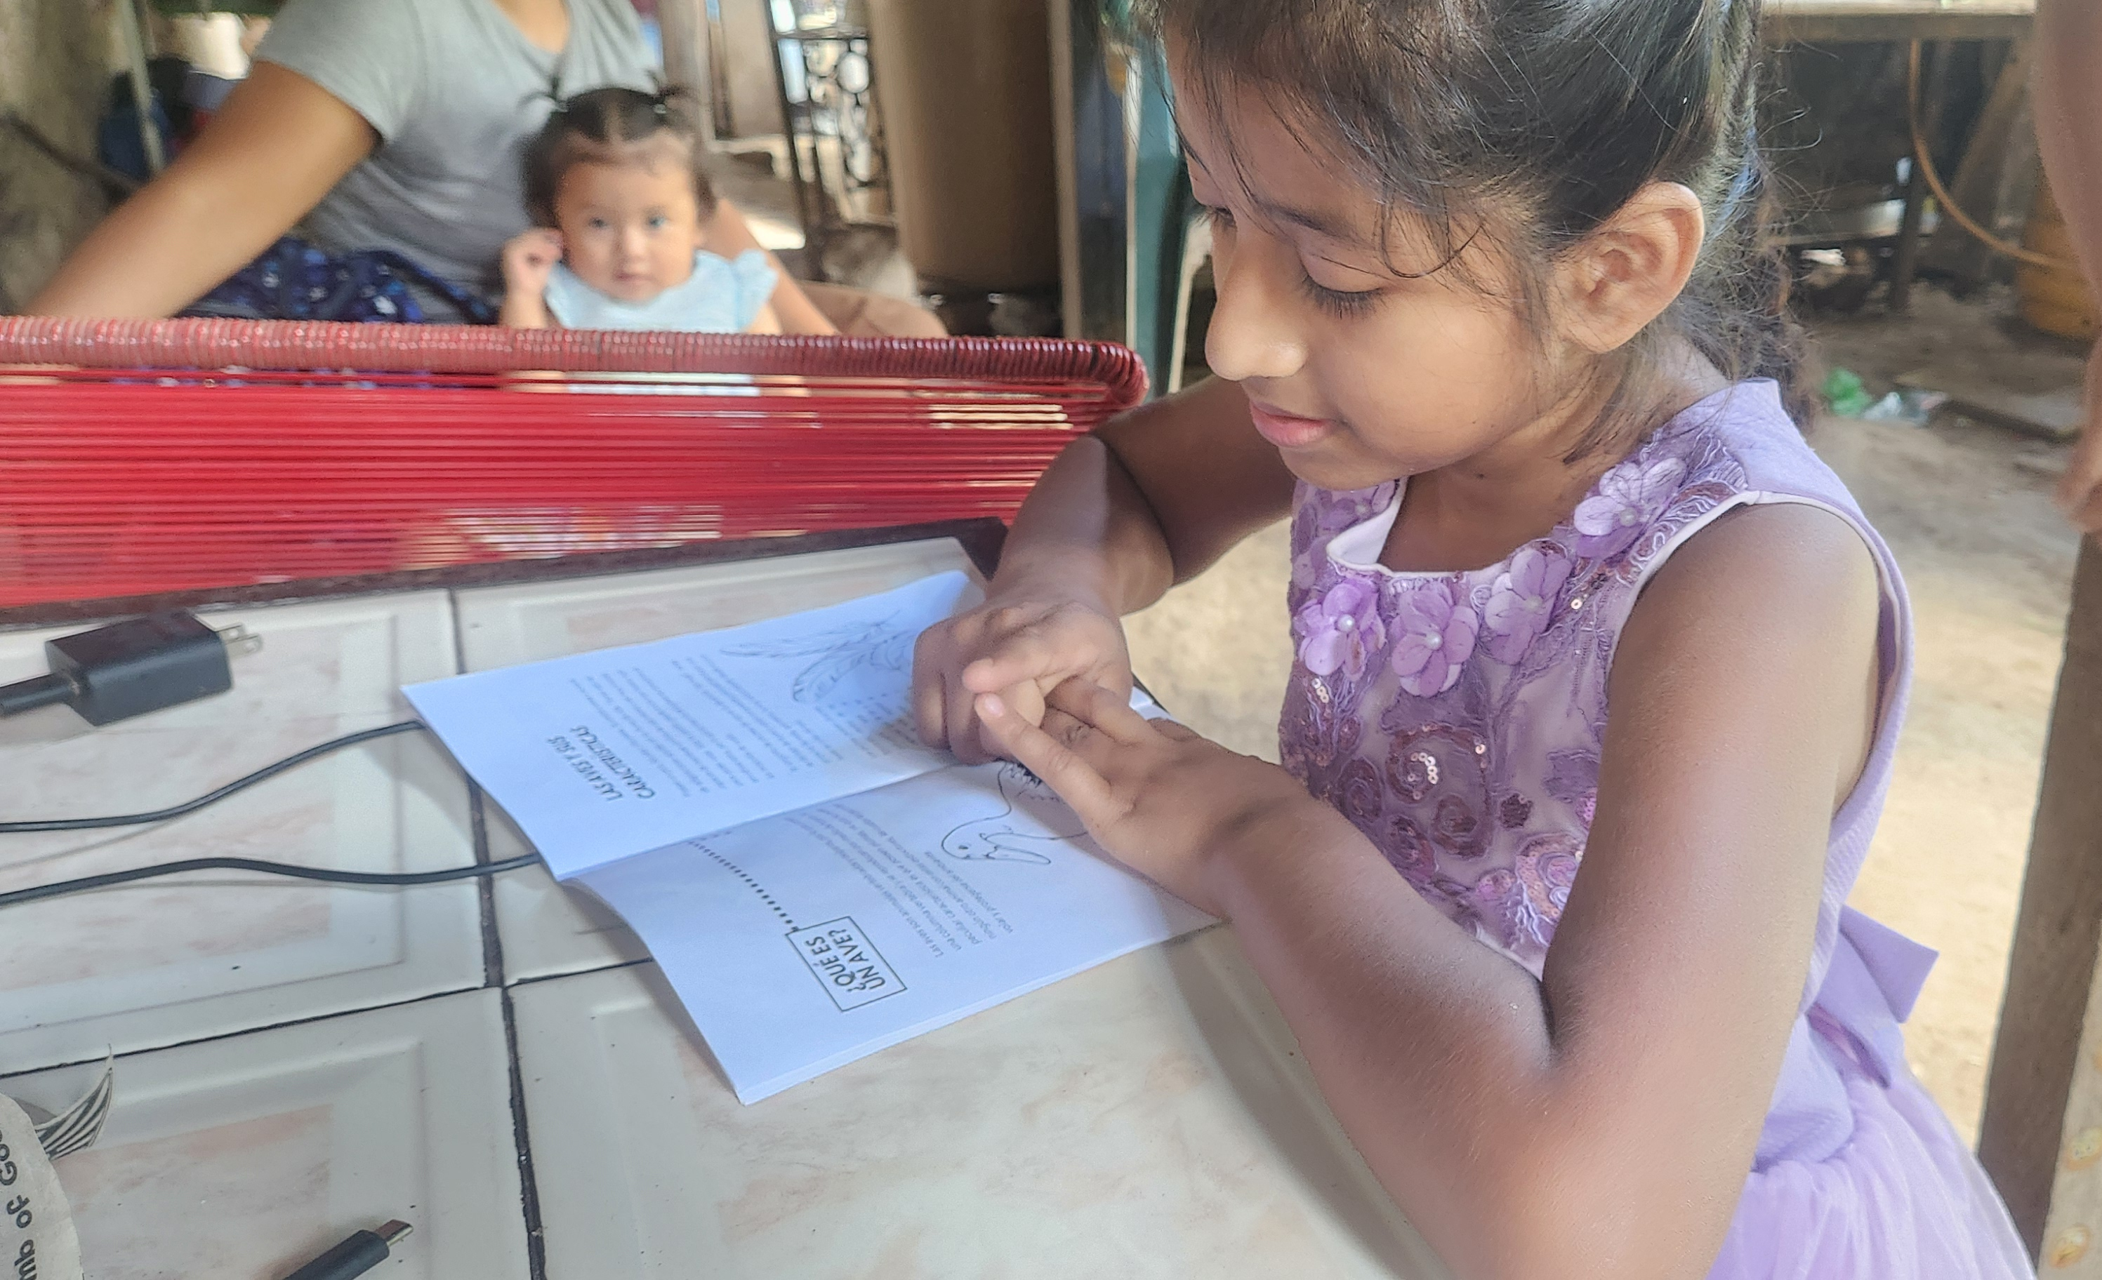
Looking Ahead to 2026
1,978
$30,000
persons with disabilities and their families targeted for 2026
unrestricted funding request to strengthen our work
Priority Areas 2026
● Strengthen social protection and access to basic services
● Expand specialized healthcare and spina bifida services
● Promote inclusive education through scholarships and assistive devices
● Strengthen advocacy and municipal registries
Challenges and Opportunities
Challenge: Short-term funding limits the continuity of specialized programs.
Opportunity: Flexible funding helps sustain sign language, low-vision and educational support services.

